Slide 1










Introduction to
Algorithm Design and Analysis
[4] QuickSort
Yu Huang
http://cs.nju.edu.cn/yuhuang Institute of Computer Software Nanjing University

Slide 2

In the Last Class …
Recursion in Algorithm Design
The divide and conquer strategy
Proving the correctness of recursive procedures
Solving recurrence equations
Some elementary techniques
Master theorem

Slide 3

Quicksort
The sorting problem
InsertionSort
Analysis of InsertionSort
Quicksort
Analysis of Quicksort

Slide 4




The Sorting Problem
Sorting
E.g., sort all the students according to their GPA
Assumptions for analysis of sorting
What to sort?
Problem size n: elements a₁,a₂,…,a_{n} with no identical keys
How to sort?
Sorting in increasing order
What are the inputs likely to be?
Each possible input appears with the same probability
Are the assumptions reasonable?

Slide 5




Comparison-Based Sorting
Sorting a number of keys
The class of “algorithms that sort by comparison of keys”
Critical operation
Comparing the keys
No other operations are allowed for sorting
Amount of work done
The number of critical operations (key comparisons)

Slide 6




As Simple as Inserting
Initial Status
Sorted
Unsorted
On Going
The “vacancy”, to be shifed leftward, by comparisons
Final Status
Sorted
Unsorted
(empty)

Slide 7

Shifting Vacancy
int shiftVac(Element[ ] E, int vacant, Key x)
Precondition: vacant is nonnegative
Postconditions: Let xLoc be the value returned to the caller, then:
Elements in E at indexes less than xLoc are in their original positions and have keys less than or equal to x.
Elements in E at positions (xLoc+1,…, vacant) are greater than x and were shifted up by one position from their positions when shiftVac was invoked.

Slide 8



Shifting Vacancy: Recursion
int shiftVacRec(Element[] E, int vacant, Key x) int xLoc
1. if (vacant==0)
xLoc=vacant;
else if (E[vacant-1].key≤x)
The recursive call is working on a smaller range, so terminating;
The second argument is non-negative, so precondition holding
4. xLoc=vacant;
5. else
E[vacant]=E[vacant-1];
xLoc=shiftVacRec(E,vacant-1,x);
8. Return xLoc
Worse case frame stack size is Ο(n)

Slide 9

Shifting Vacancy: Iteration
int shiftVac(Element[] E, int xindex, Key x) int vacant, xLoc;
vacant=xindex;
xLoc=0; //Assume failure
while (vacant>0)
if (E[vacant-1].key≤x) xLoc=vacant; //Succeed break;
E[vacant]=E[vacant-1]; vacant--; //Keep Looking
return xLoc

Slide 10



InsertionSort: the Algorithm
Input: E(array), n≥0(size of E)
Output: E, ordered nondecreasingly by keys
Procedure:
void InsertionSort(Element[] E, int n)
int xindex;
for (xindex=1; xindex<n; xindex++)
Element current=E[xindex]; Key x=current.key;
int xLoc=shiftVac(E,xindex,x);
E[xLoc]=current;
return;

Slide 11


Worst-Case Analysis
Sorted (i entries)
x
To find the right position for x in the sorted segment, i comparisons must be done in the worst case.
At the beginning, there are n-1 entries in the unsorted segment, so:
The input for which the upper bound is reached does exist, so: W(n)∈Θ(n²)
n−1
_{i =} n(n −1)
W (n) ≤
∑
i=1
2

Slide 12



Average-case Behavior
Sorted (i entries)
x
x may be located in any one of the i+1 intervals(inclusive), assumingly, with the same probability
Assumptions:
All permutations of the keys are equally likely as input.
There are not different entries with the same keys.
Note: For the (i+1)th interval (leftmost), only one comparisons is needed.

Slide 13

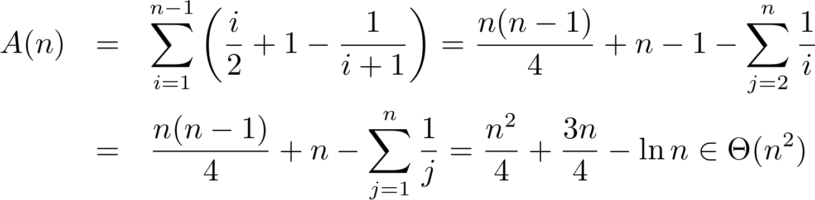
Average Complexity
The expected number of comparisons in shiftVac to find the location for the i+1th element:
1
i
1
i i i 1 2 i +1 2 i +1
∑
j =1
j +
(i) =
+ = +1−
i +1
i +1
for the leftmost interval
For all n-1 insertions:

Slide 14


Inversion and Sorting
An unsorted sequence E:
o {x₁, x₂, x₃, …, x_{n-1}, x_{n}} = {1,2,3,…,n-1,n}
<x_{i}, x_{j}> is an inversion if x_{i}>x_{j}, but i<j
Sorting ≡ Eliminating inversions
o All the inversions must be eliminated during the process of sorting

Slide 15


Eliminating Inverses: Worst Case
Local comparison is done between two adjacent elements
At most one inversion is removed by a local comparison
There do exist inputs with n(n-1)/2 inversions, such as (n,n-1,…,3,2,1)
The worst-case behavior of any sorting algorithm that remove at most one inversion per key comparison must in Ω(n²)

Slide 16


Eliminating Inversions: Average Case
Computing the average number of inversions in inputs of size n (n>1):
o Transpose:
x₁, x₂, x₃, …, x_{n-1}, x_{n}
x_{n}, x_{n-1}, …, x₃, x₂, x₁
For any i, j, (1≤j≤i≤n), the inversion (x_{i},x_{j} ) is in exactly one sequence in a transpose pair.
The number of inversions (x_{i},x_{j} ) on n distinct integers is n(n-1)/2.
So, the average number of inversions in all possible inputs is n(n- 1)/4, since exactly n(n-1)/2 inversions appear in each transpose pair.
The average behavior of any sorting algorithm that remove at most one inversion per key comparison must in Ω(n²)

Slide 17


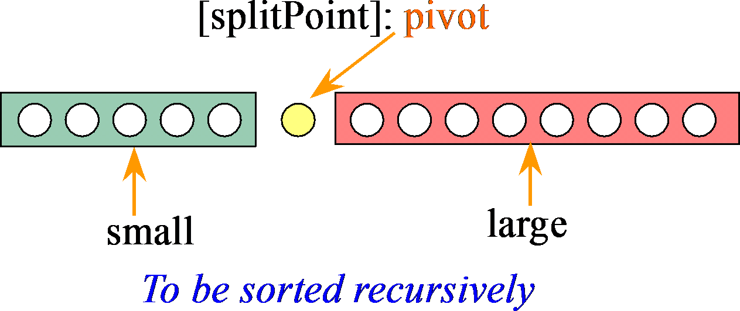
QuickSort: the Strategy
Divide the array to be sorted into two parts: “small” and “large”, which will be sorted recursively.
[first]
[last]
for any element in this segment, the key is less than pivot.
for any element in this segment, the key is not less than pivot.

Slide 18







Quicksort: the Strategy
Divide
o “small” and ”large”
Conquer
Hard divide, Easy combination
o Sort “small” and ”large” recursively
Combine
o Easily combine sorted sub-array
[splitPoint]: pivot
[first]
[last]
Lectures on Algorithm Design &sAmnaalylslis (LADA) 2015
large
2015/3/10
18

Slide 19




QuickSort: the Algorithm
Input: Array E and indexes first, and last, such that elements E[i] are defined for first≤i≤last.
Output: E[first],…,E[last] is a sorted rearrangement of the same elements.
The procedure:
void quickSort(Element[ ] E, int first, int last) if (first<last)
Element pivotElement=E[first]; Key pivot=pivotElement.key;
The splitting point is chosen arbitrarily, as the first element in the array segment here.
int splitPoint=partition(E, pivot, first, last); E[splitPoint]=pivotElement;
quickSort(E, first, splitPoint-1); quickSort(E, splitPoint+1, last);
return

Slide 20


















Partition: the Strategy
Expanding Directions
“Small” segment
Unexamined segment “Large” segment

Slide 21





















Partition: the Process
Always keep a vacancy before completion.
Vacancy at beginning, the key as pivot
First met key that is less than pivot
Moving as far as possible!
highVac
First met key that is larger than pivot
lowVac
Vacant left after moving
Lectures on Algorithm Design & Analysis (LADA) 2015
2015/3/10
21

Slide 22

Partition: the Algorithm
Input: Array E, pivot, the key around which to partition, and indexes first, and last, such that elements E[i] are defined for first+1≤i≤last and E[first] is vacant. It is assumed that first<last.
Output: Returning splitPoint, the elements origingally in first+1,…,last are rearranged into two subranges, such that
o the keys of E[first], …, E[splitPoint-1] are less than pivot, and
o the keys of E[splitPoint+1], …, E[last] are not less than pivot, and
o first≤splitPoint≤last, and E[splitPoint] is vacant.

Slide 23


Partition: the Procedure
int partition(Element [ ] E, Key pivot, int first, int last) int low, high;
low=first; high=last;
while (low<high)
int highVac =
extendLargeRegion(E,pivot,low,high);
int lowVac =
extendSmallRegion(E,pivot,low+1,highVac);
low=lowVac; high=highVac-1;
6 return low; //This is the splitPoint
highVac has been filled now

Slide 24

Extending Regions
Specification for
extendLargeRegion(Element[ ] E, Key pivot, int lowVac, int high)
Precondition:
lowVac<high
Postcondition:
If there are elements in E[lowVac+1],...,E[high] whose key is less than pivot, then the rightmost of them is moved to E[lowVac], and its original index is returned.
If there is no such element, lowVac is returned.

Slide 25

An Example
45 | 14 | 62 | 51 | 75 | 96 | 33 | 84 | 20
 |  |  |  |  |  |  |  | high
20 | 14 | 62 | 51 | 75 | 96 | 33 | 84
 |  |  |  |  |  |  |  | highVac
20 | 14 |  | 51 | 75 | 96 | 33 | 84 | 62
 |  | lowVac
20 | 14 |  | 51 | 75 | 96 | 33 | 84 | 62
low high =highVac-1
45 as pivot _{low}
20 | 14 | 33 | 51 | 75 | 96 |  | 84 | 62
 |  |  |  |  |  | highVac
20 | 14 | 33 |  | 75 | 96 | 51 | 84 | 62
 |  |  | lowVac |  |  | highVac
To be processed in the next loop

Slide 26

Worst Case: a Paradox
For a range of k positions, k-1 keys are compared with the pivot(one is vacant).
If the pivot is the smallest, than the “large” segment has all the remaining k-1 elements, and the “small” segment is empty.
If the elements in the array to be sorted has already in ascending order(the Goal), then the number of comparison that Partition has to do is:
∑(k −1) =
k =2
n
n(n −1)
2
∈ Ο(n )
2

Slide 27


Average-case Analysis
Assumption: all permutation of the keys are equally likely.
A(n) is the average number of key comparisons done for range of size n.
In the first cycle of Partition, n-1 comparisons are done
If split point is E[i](each i has probability 1/n), Partition is to be executed recursively on the subrange [0,…i-1] and [i+1,…,n-1]

Slide 28











The Recurrence Equation
splitPoint: E[i]
E[0] E[n-1]
why the assumed probability still holds for each subrange?
subrange 1: size= i subrange 2: size= n-1-i
with i∈{0,1,2,…n-1}, each value with the probability 1/n So, the average number of key comparison A(n) is:
n−1 ₁
A(n) = (n −1) + _{∑ n} [ A(i) + A(n −1− i)]
for n ≥ 2
i=0
and A(1)=A(0)=0
The number of key comparison in the first cycle(finding the splitPoint) is n-1

Slide 29


Simplified Recurrence Equation
n−1 n−1
∑ A(i) = ∑ A[(n −1) − i]
i=0 i=0
Note:
and A(0) = 0
₂ n−1
A(n) = (n −1) + ∑ A(i)
n
So:
for n ≥ 1
i=1
Two approaches to solve the equation
Guess, and prove by induction
Solve directly

Slide 30

Guess the Solution
A special case as clue for guess
Assuming that Partition divide the problem range into 2 subranges of about the same size.
So, the number of comparison Q(n) satisfy:
Q(n) ≈ n+2Q(n/2)
Applying Master Theorem, case 2:
Q(n)∈Θ(nlogn)
Note: here, b=c=2, so E=log(b)/log(c)=1, and, f(n) =n^{E}=n

Slide 31







Inductive Proof: A(n)∈O(nlnn)
Theorem: A(n)≤cnlnn for some constant c, with A(n) defined by the recurrence equation above.
Proof:
By induction on n, the number of elements to be sorted. Base case(n=1) is trivial.
Inductive assumption: A(i)≤cilni for 1≤i<n
₂ n−1 ₂ n−1
A(n) = (n −1) + ∑ A(i) ≤ (n −1) + ∑ci ln(i)
n n
i=1 i=1
₂ n−1
_{n}2 ⎞
Note : ∑ci ln(i) ≤
n n
cn
2c
∫
n
2c ⎛ n² ln(n)
x ln xdx ≈
⎜
n
⎟ = cn ln(n) −
4 2
1
⎜
2
⎟
i=1
⎝
⎠
⎛ c ⎞
So, A(n) ≤ cn ln(n) + n 1− −1
⎜ ⎟
⎝
2 ⎠
Let c = 2, we have A(n) ≤ 2n ln(n)

Slide 32


For Your Reference
n
x^{k} ln(x)dx =
1
1
1
_{n}k +1
∫
n^{k +1} ln(n) −
k +1
(k +1)²
n
∑
i=1
¹ ≈ ln(n) + 0.577
i
Harmonic Series
b
b
b+1
∫
f (x)dx ≤
∑
i=a
f (i) ≤
∫
f (x)dx
a−1
a
a
b

Slide 33


Inductive Proof: A(n)∈Ω(nlnn)
Theorem: A(n)>cnlnn for some co c, with large n
Inductive reasoning:
Inductive assumption
∑
i=1
∑
i=1
A(n) = (n − 1) + ^{2 n−1} A(i) > (n − 1) + ^{2 n−1} ci ln(i)
n
n
2c n
n
2c n
n
= (n − 1) +
∑
i ln(i) − 2c ln(n) ≥ (n − 1) +
∫
x ln xdx − 2c ln(n)
i=2
1
≈ cnln(n) + [(n − 1) − c( ^{n} + 2ln n)]
2
, then A(n) > cnln(n) (Note : lim
n − 1
n − 1
Let c <
= 2)
^{n} + 2ln(n)
^{n→∞ n} + 2ln(n)
2
2

Slide 34


Directly Derived Recurrence Equation
∑
i=1
We have : A(n) = (n − 1) + ^{2 n−1} A(i) and
n
2
n−2
A(i)
A(n − 1) = (n − 2) +
∑
i=1
n − 1
Combining the 2 equations in some way, we can remove all A(i) for i=1,2,…,n-2
nA(n) − (n − 1) A(n − 1)
= n(n − 1) + 2∑ A(i) − (n − 1)(n − 2) − 2∑ A(i)
n−1 n−2
i=1
= 2 A(n − 1) + 2(n − 1)
So, nA(n) = (n + 1) A(n − 1) + 2(n − 1)
i=1

Slide 35


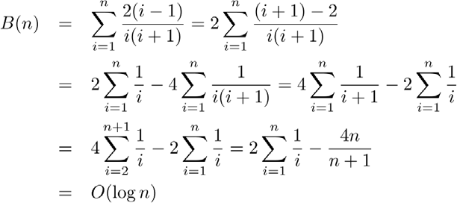
Solve the Equation
Let it be B(n)
A(n) ₌ A(n − 1) ₊ 2(n − 1)
n + 1 n n(n + 1)
nA(n) = (n + 1) A(n − 1) + 2(n − 1)
We have: B(n) = B(n − 1) + ^{2(n − 1)}
B(1) = 0
n(n + 1)
o Thus: B(n) = O(log n)
Finally we get
o A(n) = O(nlogn)

Slide 36

Space Complexity
Good news:
Partition is in-place
Bad news:
In the worst case, the depth of recursion will be n-1
So, the largest size of the recursion stack will be in Θ(n)

Slide 37




Thank you!
Q & A
Yu Huang
http://cs.nju.edu.cn/yuhuang

